Slide 1


PHASE ONE PROJECT AIRCRAFT ACCIDENT ANALYSIS

Slide 2
Business Understanding/Overview
I am charged with determining which aircrafts have the lowest risk for the company to start a new business since it is trying to expand and diversify its portfolio.
They are interested in purchasing and operating airplanes for both commercial and private enterprises, but do not know anything about the potential risks of aircraft.
My aim is to assist look at the data, analyze then translate my findings into actionable insights that the head of the new aviation division can use to help decide which aircraft to purchase

Slide 3
Problem Statement
The company wants to get into new industries and explore aircrafts for commercial and private purposes and it requires assessment form the data to identify low-risk aircraft. The goal is to recommend low risk aircraft that are suitable for successful market entry. Actionable insights will guide the aviation division in making informed purchasing decisions.

Slide 4
Objective
1. Analyze past data to identify accident trends over time and determine whether accident rates are improving or worsening
2. Identify and compare accident rates versus aircraft model to find the ones with the lowest accident rate and the safest
3. Look at the location with most accidents to identify regions or routes with higher risk which will help in planning and strategic deployment of the aircraft.

Slide 5
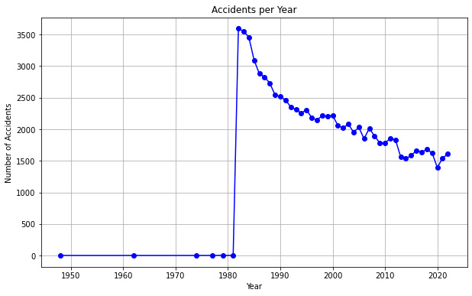
2. Analyze past data to identify accident trends over time and determine whether accident rates are improving or worsening
Up until 1980, the number of accidents remained stable, showing little to no change.
This could suggest that either accidents were not being recorded or that there were fewer airlines in operation during that time.
An unusual event happened in 1980 which caused a spike but the accident rates started improving significantly

Slide 6
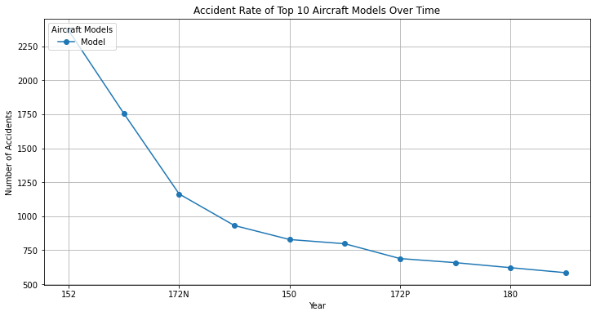
2. Identify and compare accident rates versus aircraft model to find the ones with the lowest accident rate and the safest
From the line graph the aircraft model with lesser accidents is the "180“
We recommend that if the airline is considering, it chooses that as opposed to the aircraft '152'

Slide 7
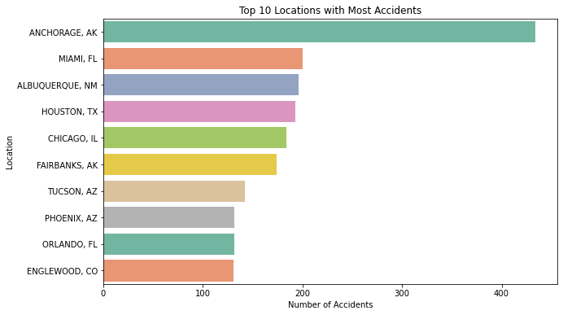
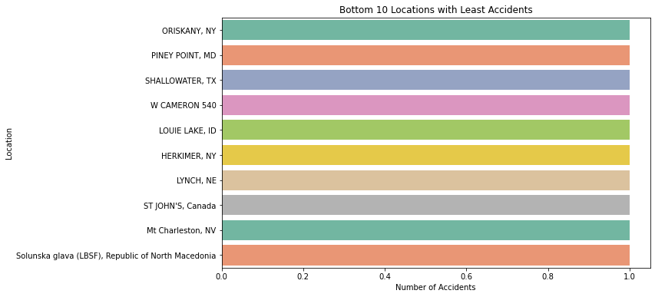
3. Look at the location with most accidents to identify regions or routes with higher risk which will help in planning and strategic deployment of the aircraft.

Slide 8
Conclusion and Recommendations
The analysis indicates that the number of accidents has decreased over time, which could be attributed to improvements in aircraft models, enhanced safety measures in accident-prone areas, and growing experience and expertise.
Recommendations:
1. When selecting aircraft, prioritize models that have a proven track record of safety and a history of stable performance over time.
2. Given the reduction in accidents, I recommend that the company consider entering the aircraft business and take on the associated risks.
3. When deploying aircraft, ensure that regions with high accident rates are avoided. For higher-risk areas, implement monitoring systems or additional safety measures to mitigate potential risks.

